Slide 1
第二章：线性模型

Slide 2
目录
线性回归
最小二乘法
二分类任务
对数几率回归
类别不平衡问题

Slide 3
基本形式
线性模型一般形式
^{T}是由属性描述的示例，其中 是 在第 个属性上的取值
向量形式
其中
^{T}

Slide 4
线性模型优点
形式简单、易于建模
可解释性
非线性模型的基础
引入层级结构或高维映射
一个例子
综合考虑色泽、根蒂和敲声来判断西瓜好不好
其中根蒂的系数最大，表明根蒂最要紧；而敲声的系数比色泽大，说明敲声比色泽更重要

Slide 5
线性回归
给定数据集
其中 ，
线性回归（linear regression）目的
学得一个线性模型以尽可能准确地预测实值输出标记

Slide 6
线性回归
单一属性的线性回归目标
参数/模型估计：最小二乘法（least square method）
使得

Slide 7
线性回归 - 最小二乘法
最小化均方误差
分别对 和 求导，可得

Slide 8
线性回归 - 最小二乘法
得到闭式（closed-form）解
其中

Slide 9

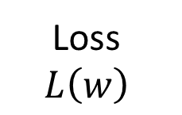
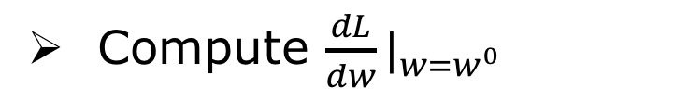
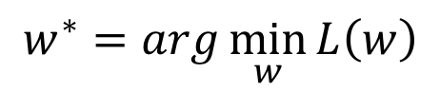
Gradient Descent
http://chico386.pixnet.net/album/photo/171572850
Consider loss function 𝐿(𝑤) with one parameter w:
$$w^{∗}=arg\min_{w}{L\left(w\right)}$$
(Randomly) Pick an initial value w⁰
Compute $\frac{dL}{dw}|_{w=w^{0}}$
Loss
$$L\left(w\right)$$
Negative
Increase w
Positive
Decrease w
w⁰

Slide 10
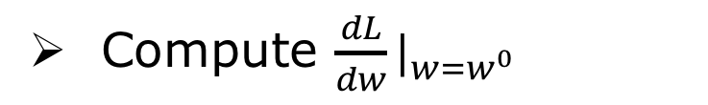
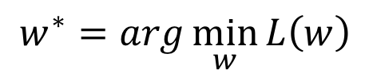
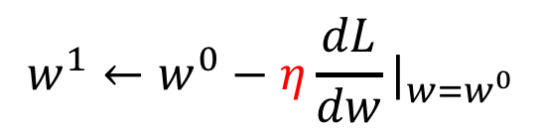
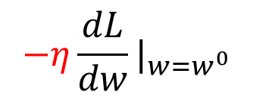
Gradient Descent
Consider loss function 𝐿(𝑤) with one parameter w:
$$w^{∗}=arg\min_{w}{L\left(w\right)}$$
(Randomly) Pick an initial value w⁰
Compute $\frac{dL}{dw}|_{w=w^{0}}$
Loss
$$L\left(w\right)$$
$$w^{1}←w^{0}−η\frac{dL}{dw}|_{w=w^{0}}$$
w⁰
$$−η\frac{dL}{dw}|_{w=w^{0}}$$
η is called “learning rate”

Slide 11

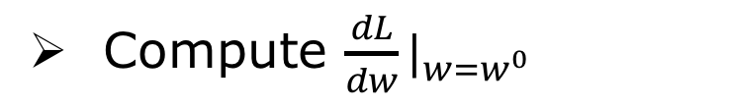
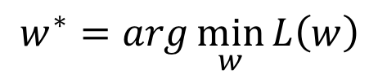

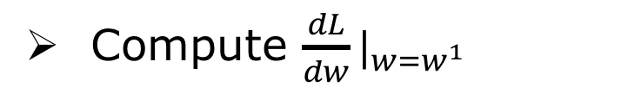
Gradient Descent
Consider loss function 𝐿(𝑤) with one parameter w:
$$w^{∗}=arg\min_{w}{L\left(w\right)}$$
(Randomly) Pick an initial value w⁰
Compute $\frac{dL}{dw}|_{w=w^{0}}$
$$w^{1}←w^{0}−η\frac{dL}{dw}|_{w=w^{0}}$$
Loss
$$L\left(w\right)$$
Compute $\frac{dL}{dw}|_{w=w^{1}}$
$$w^{2}←w^{1}−η\frac{dL}{dw}|_{w=w^{1}}$$
…… Many iteration
Local minima
global minima
w⁰
w¹
w²
w^{T}

Slide 12
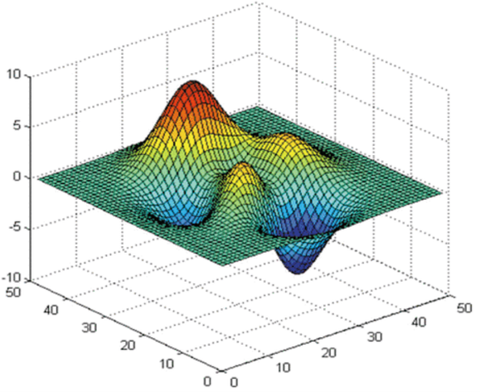
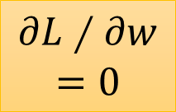
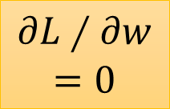
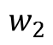
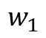
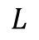

Gradient Descent
$$L$$
Loss
Very slow at the plateau
$$w_{1}$$
$$w_{2}$$
Stuck at saddle point
Stuck at local minima
$$∂L∕∂w$$
$$≈0$$
$$∂L∕∂w$$
$$=0$$
$$∂L∕∂w$$
$$=0$$
The value of the parameter w
Notes:
Demo: Why all the problmes/

Slide 13
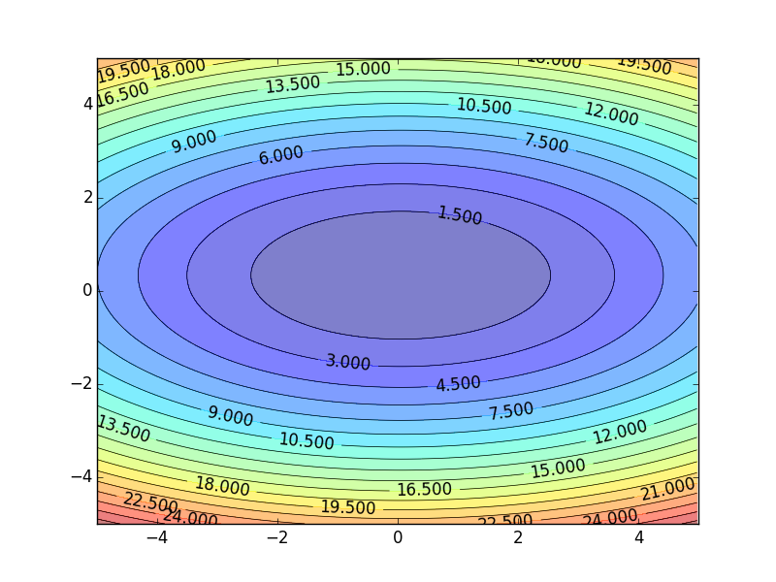
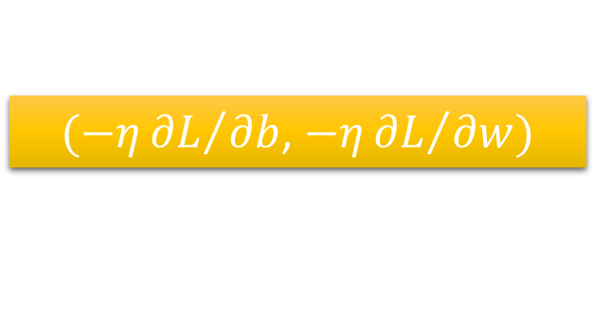
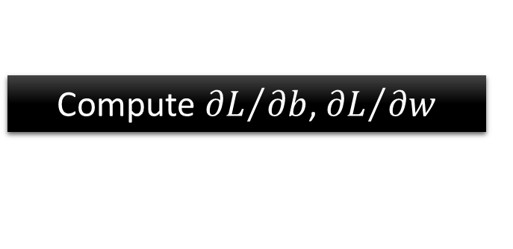

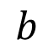
Gradient Descent
Color: Value of Loss L(w,b)
$$w$$
$(−η{∂L}/{∂b}$, $−η{∂L}/{∂w})$
Compute ${∂L}/{∂b}$, ${∂L}/{∂w}$
$$b$$
Notes:
Don’t worry. In linear regression, the loss function L is convex.
No local minima
Questions: image you are playing AOC
A network can have millions of parameters.
Backpropagation is the way to compute the gradients efficiently (not today)
Ref: http://speech.ee.ntu.edu.tw/~tlkagk/courses/MLDS_2015_2/Lecture/DNN%20backprop.ecm.mp4/index.html

Slide 14
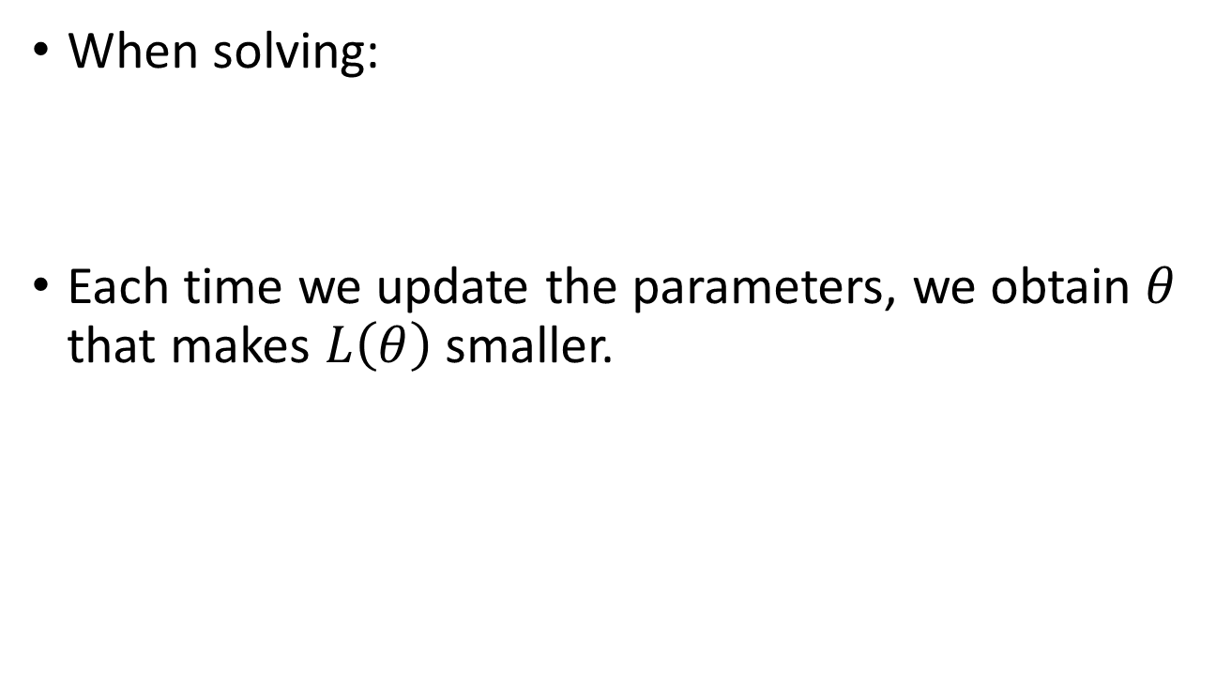
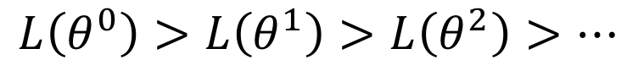
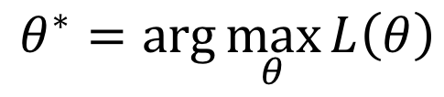
Gradient Descent
When solving:
Each time we update the parameters, we obtain $θ$ that makes $L\left(θ\right)$ smaller.
$$θ^{∗}=arg\max_{θ}{L\left(θ\right)}$$
by gradient descent
$$L\left(θ^{0}\right)>L\left(θ^{1}\right)>L\left(θ^{2}\right)>…$$
Is this statement correct?
Notes:
Demo minecraft

Slide 15
Learning Rate
If there are more than three parameters, you cannot visualize this.
Set the learning rate η carefully
Loss
Very Large
small
Large
Loss
Just make
No. of parameters updates
But you can always visualize this.

Slide 16
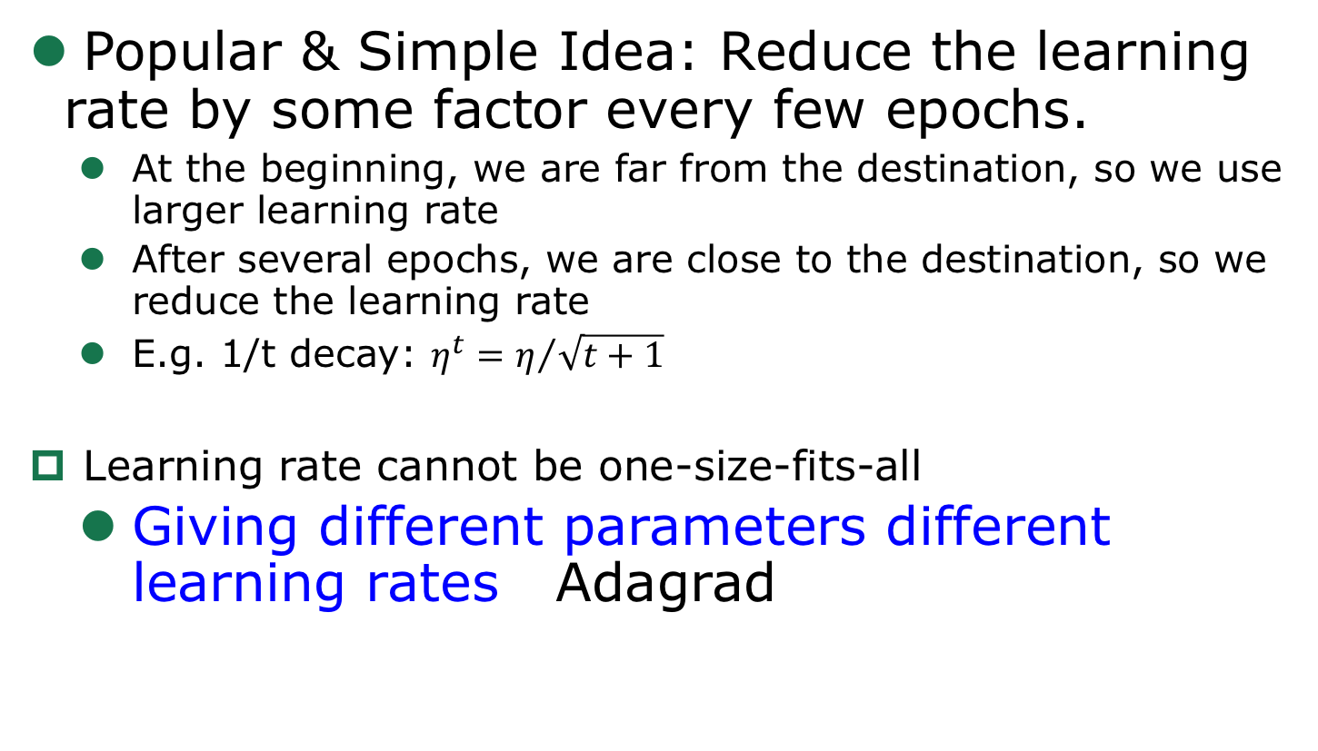
Adaptive Learning Rates
Popular & Simple Idea: Reduce the learning rate by some factor every few epochs.
At the beginning, we are far from the destination, so we use larger learning rate
After several epochs, we are close to the destination, so we reduce the learning rate
E.g. 1/t decay: $η^{t}=η/{\sqrt{t+1}}$
Learning rate cannot be one-size-fits-all
Giving different parameters different learning rates Adagrad
Notes:
Advanced Idea: Eta
Can we give each parameters different learning rates?

Slide 17
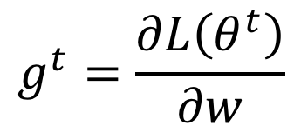
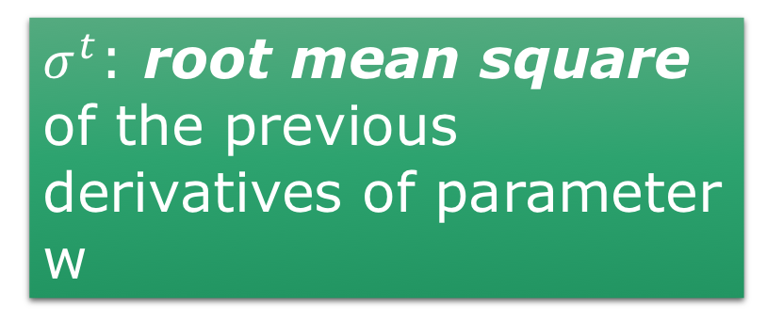
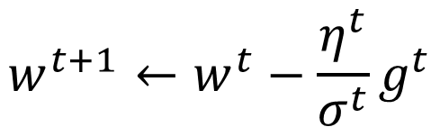
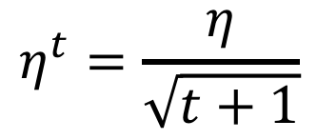
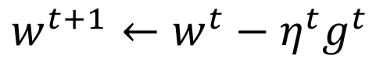
Adagrad
$$η^{t}=\frac{η}{\sqrt{t+1}}$$
$$g^{t}=\frac{∂L\left(θ^{t}\right)}{∂w}$$
Divide the learning rate of each parameter by the root mean square of its previous derivatives
Vanilla Gradient descent
w is one parameters
$$w^{t+1}←w^{t}−{\text{η}}^{t}g^{t}$$
$σ^{t}$: root mean square of the previous derivatives of parameter w
Adagrad
$$w^{t+1}←w^{t}−\frac{{\text{η}}^{t}}{σ^{t}}g^{t}$$
Parameter dependent

Slide 18
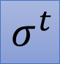
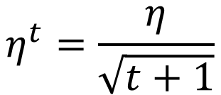
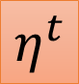
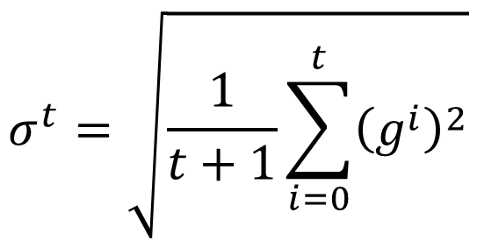
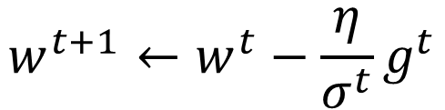
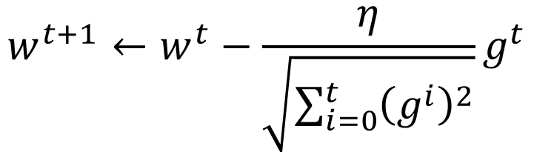
Adagrad
Divide the learning rate of each parameter by the root mean square of its previous derivatives
$$η^{t}=\frac{η}{\sqrt{t+1}}$$
1/t decay
$${\text{η}}^{t}$$
$$w^{t+1}←w^{t}−\frac{η}{σ^{t}}g^{t}$$
$$σ^{t}=\sqrt{\frac{1}{t+1}\sum_{i=0}^{t}{{\left(g^{i}\right)}^{2}}}$$
$$σ^{t}$$
$$w^{t+1}←w^{t}−\frac{η}{\sqrt{\sum_{i=0}^{t}{{\left(g^{i}\right)}^{2}}}}g^{t}$$

Slide 19
多元线性回归
给定数据集
多元线性回归目标
使得

Slide 20
多元线性回归
把 和 吸收入向量形式 ，数据集表示为

Slide 21
多元线性回归 - 最小二乘法
最小二乘法（least square method）
令
，对 求导得到
令上式为零可得 最优解的闭式解

Slide 22
多元线性回归 - 满秩讨论
是满秩矩阵或正定矩阵，则
其中 是 的逆矩阵，线性回归模型为
不是满秩矩阵
根据归纳偏好选择解（参见1.4节）
引入正则化（参加6.4节，11.4节）

Slide 23
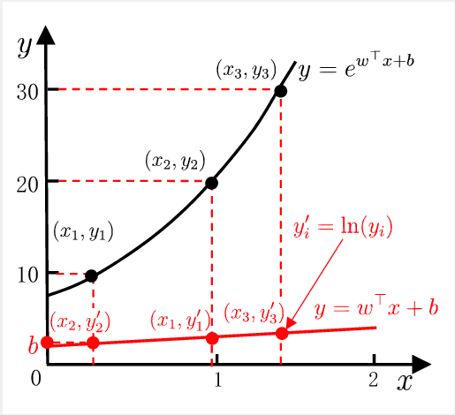
对数线性回归
输出标记的对数为线性模型逼近的目标

Slide 24
线性回归 - 广义线性模型
一般形式
称为联系函数（link function）
单调可微函数
对数线性回归是 时广义线性模型的特例

Slide 25
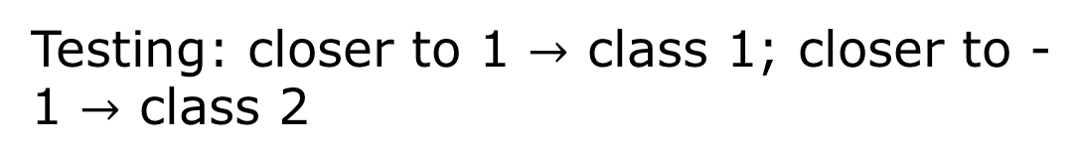
How to do Classification
Classification as Regression?
Binary classification as example
Training: Class 1 means the target is 1; Class 2 means the target is -1
Testing: closer to 1 $→$ class 1; closer to -1 $→$ class 2

Slide 26
b + w₁x₁ + w₂x₂ = 0
to decrease error
Class 2
Class 2
-1
-1
1
1
x₂
Multiple class: Class 1 means the target is 1; Class 2 means the target is 2; Class 3 means the target is 3 …… problematic
x₂
Class 1
Class 1
>>1
y = b + w₁x₁ + w₂x₂
error
x₁
x₁
Penalize to the examples that are “too correct” …
(Bishop, P186)
Notes:
-0.142857142857 0.285714285714

Slide 27
二分类任务
预测值与输出标记
寻找函数将分类标记与线性回归模型输出联系起来
最理想的函数——单位阶跃函数
预测值大于零就判为正例，小于零就判为反例，预测值为临界值零则可任意判别

Slide 28
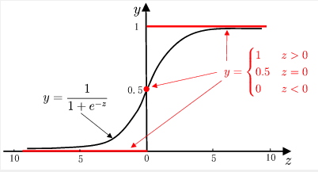
二分类任务
单位阶跃函数缺点
不连续
替代函数——对数几率函数（logistic function）
单调可微、任意阶可导
单位阶跃函数与对数几率函数的比较

Slide 29
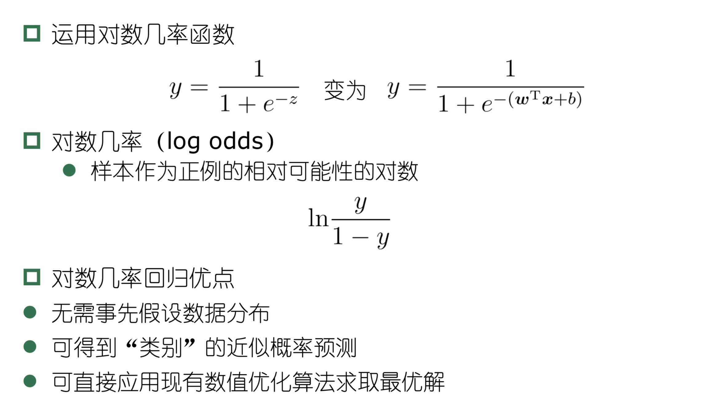
对数几率回归

Slide 30
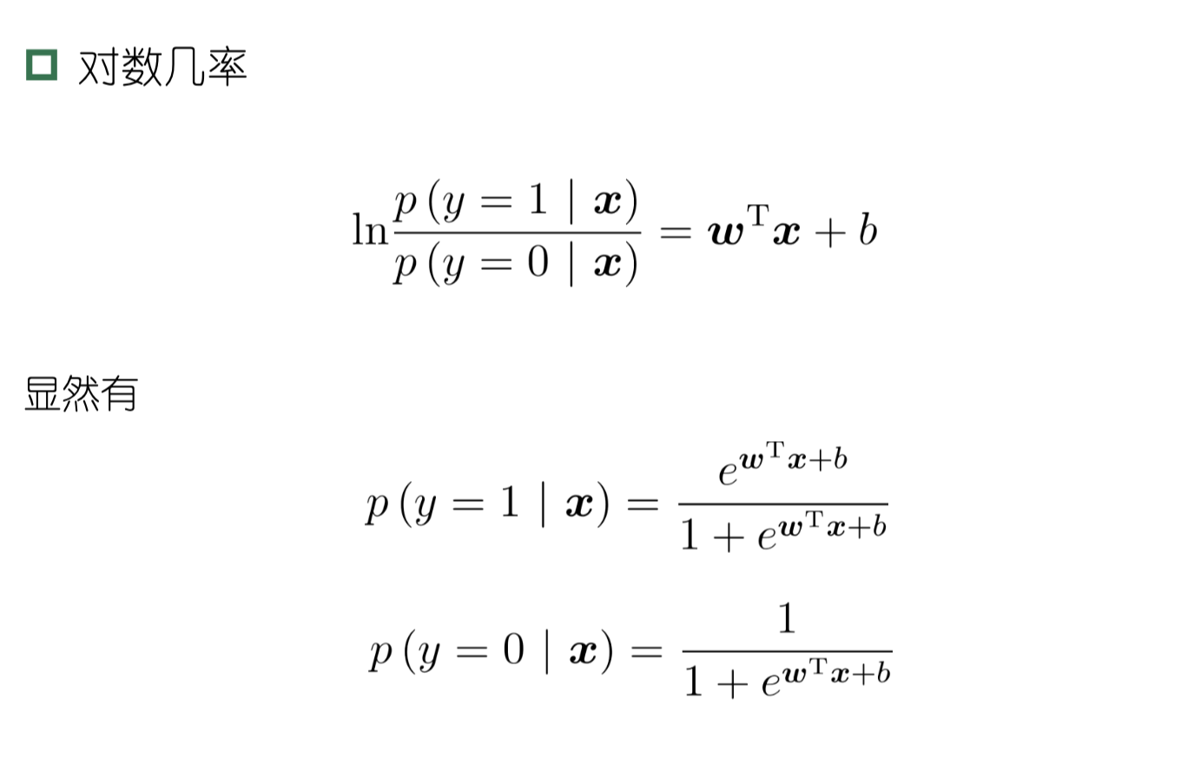
对数几率回归 - 极大似然法

Slide 31
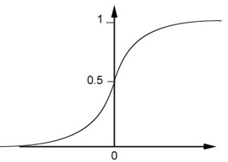
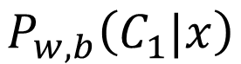
…
…
$$P_{w,b}\left(C_{1}|x\right)$$
…
…
Sigmoid Function
Notes:
李宏毅PPT
Activation function

Slide 32
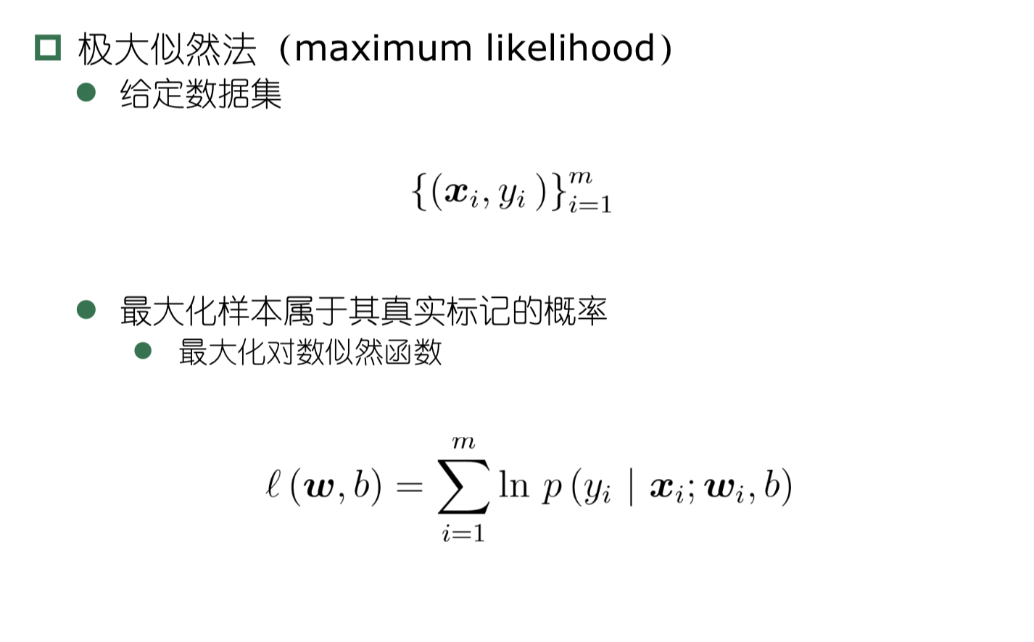
对数几率回归 - 极大似然法

Slide 33
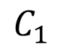
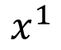
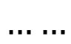
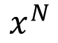
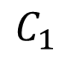
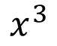
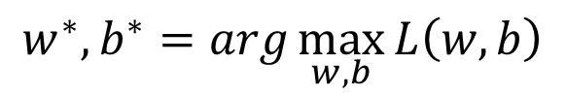



Training
Data
$$x^{1}$$
$$x^{2}$$
$$x^{3}$$
$$x^{N}$$
$$……$$
$$C_{1}$$
$$C_{1}$$
$$C_{2}$$
$$C_{1}$$
Assume the data is generated based on $f_{w,b}\left(x\right)=P_{w,b}\left(C_{1}|x\right)$
Given a set of w and b, what is its probability of generating the data?
$$L\left(w,b\right)=f_{w,b}\left(x^{1}\right)f_{w,b}\left(x^{2}\right)\left(1−f_{w,b}\left(x^{3}\right)\right)⋯f_{w,b}\left(x^{N}\right)$$
The most likely w* and b* is the one with the largest $L\left(w,b\right)$.
$$w^{∗},b^{∗}=arg\max_{w,b}{L\left(w,b\right)}$$
Notes:
All the w and b give non-zero probability

Slide 34




















$$x^{1}$$
$$x^{2}$$
$$x^{3}$$
$$x^{1}$$
$$x^{2}$$
$$x^{3}$$
$$……$$
$$……$$
$$C_{1}$$
$$C_{1}$$
$$C_{2}$$
$${\hat{y}}^{1}=1$$
$${\hat{y}}^{2}=1$$
$${\hat{y}}^{3}=0$$
${\hat{y}}^{n}$: 1 for class 1, 0 for class 2
$$L\left(w,b\right)=f_{w,b}\left(x^{1}\right)f_{w,b}\left(x^{2}\right)\left(1−f_{w,b}\left(x^{3}\right)\right)⋯$$
$$w^{∗},b^{∗}=arg\max_{w,b}{L\left(w,b\right)}$$
=
$$w^{∗},b^{∗}=arg\min_{w,b}{−lnL\left(w,b\right)}$$
$$−lnL\left(w,b\right)$$
$$=−lnf_{w,b}\left(x^{1}\right)$$
1
$$−\left[{\hat{y}}^{1}lnf\left(x^{1}\right)+\left(1−{\hat{y}}^{1}\right)ln\left(1−f\left(x^{1}\right)\right)\right]$$
0
$$−lnf_{w,b}\left(x^{2}\right)$$
1
$$−\left[{\hat{y}}^{2}lnf\left(x^{2}\right)+\left(1−{\hat{y}}^{2}\right)ln\left(1−f\left(x^{2}\right)\right)\right]$$
0
$$−ln\left(1−f_{w,b}\left(x^{3}\right)\right)$$
$$−\left[{\hat{y}}^{3}lnf\left(x^{3}\right)+\left(1−{\hat{y}}^{3}\right)ln\left(1−f\left(x^{3}\right)\right)\right]$$
0
1
……

Slide 35







$$L\left(w,b\right)=f_{w,b}\left(x^{1}\right)f_{w,b}\left(x^{2}\right)\left(1−f_{w,b}\left(x^{3}\right)\right)⋯f_{w,b}\left(x^{N}\right)$$
$$−lnL\left(w,b\right)=lnf_{w,b}\left(x^{1}\right)+lnf_{w,b}\left(x^{2}\right)+ln\left(1−f_{w,b}\left(x^{3}\right)\right)⋯$$
${\hat{y}}^{n}$: 1 for class 1, 0 for class 2
$$=\sum_{n}{−\left[{\hat{y}}^{n}lnf_{w,b}\left(x^{n}\right)+\left(1−{\hat{y}}^{n}\right)ln\left(1−f_{w,b}\left(x^{n}\right)\right)\right]}$$
Cross entropy between two Bernoulli distribution
Distribution p:
Distribution q:
$$p\left(x=1\right)={\hat{y}}^{n}$$
cross entropy
$$q\left(x=1\right)=f\left(x^{n}\right)$$
$$p\left(x=0\right)={1−\hat{y}}^{n}$$
$$q\left(x=0\right)=1−f\left(x^{n}\right)$$
$$H\left(p,q\right)=−\sum_{x}{p\left(x\right)ln\left(q\left(x\right)\right)}$$
Notes:
Where does it comes from?

Slide 36





$$L\left(w,b\right)=f_{w,b}\left(x^{1}\right)f_{w,b}\left(x^{2}\right)\left(1−f_{w,b}\left(x^{3}\right)\right)⋯f_{w,b}\left(x^{N}\right)$$
$$−lnL\left(w,b\right)=lnf_{w,b}\left(x^{1}\right)+lnf_{w,b}\left(x^{2}\right)+ln\left(1−f_{w,b}\left(x^{3}\right)\right)⋯$$
${\hat{y}}^{n}$: 1 for class 1, 0 for class 2
$$=\sum_{n}{−\left[{\hat{y}}^{n}lnf_{w,b}\left(x^{n}\right)+\left(1−{\hat{y}}^{n}\right)ln\left(1−f_{w,b}\left(x^{n}\right)\right)\right]}$$
Cross entropy between two Bernoulli distribution
minimize
1.0
$$f\left(x^{n}\right)$$
0.0
cross entropy
$$1−f\left(x^{n}\right)$$
Ground Truth
$${\hat{y}}^{n}=1$$
Notes:
Where does it comes from?

Slide 37


















Find the best function
$$\left(1−f_{w,b}\left(x^{n}\right)\right)x_{i}^{n}$$
$$=\sum_{n}{−\left[{\hat{y}}^{n}lnf_{w,b}\left(x^{n}\right)+\left(1−{\hat{y}}^{n}\right)ln\left(1−f_{w,b}\left(x^{n}\right)\right)\right]}$$
$$−lnL\left(w,b\right)$$
$$∂w_{i}$$
$$∂w_{i}$$
$$∂w_{i}$$
$$\frac{∂lnf_{w,b}\left(x\right)}{∂w_{i}}=\frac{∂lnf_{w,b}\left(x\right)}{∂z}\frac{∂z}{∂w_{i}}$$
$$\frac{∂z}{∂w_{i}}=x_{i}$$
$$σ\left(z\right)$$
$$\frac{∂σ\left(z\right)}{∂z}$$
$$\frac{∂lnσ\left(z\right)}{∂z}$$
$$=\frac{1}{σ\left(z\right)}\frac{∂σ\left(z\right)}{∂z}$$
$$=\frac{1}{σ\left(z\right)}σ\left(z\right)\left(1−σ\left(z\right)\right)$$
$$f_{w,b}\left(x\right)$$
$$=σ\left(z\right)$$
$$z=w∙x+b=\sum_{i}{w_{i}x_{i}}+b$$
$$=1/{1+exp\left(−z\right)}$$

Slide 38










Find the best function
$$\left(1−f_{w,b}\left(x^{n}\right)\right)x_{i}^{n}$$
$$−f_{w,b}\left(x^{n}\right)x_{i}^{n}$$
$$=\sum_{n}{−\left[{\hat{y}}^{n}lnf_{w,b}\left(x^{n}\right)+\left(1−{\hat{y}}^{n}\right)ln\left(1−f_{w,b}\left(x^{n}\right)\right)\right]}$$
$$−lnL\left(w,b\right)$$
$$∂w_{i}$$
$$∂w_{i}$$
$$∂w_{i}$$
$$\frac{∂ln\left(1−f_{w,b}\left(x\right)\right)}{∂w_{i}}=\frac{∂ln\left(1−f_{w,b}\left(x\right)\right)}{∂z}\frac{∂z}{∂w_{i}}$$
$$\frac{∂z}{∂w_{i}}=x_{i}$$
$$\frac{∂ln\left(1−σ\left(z\right)\right)}{∂z}$$
$$=−\frac{1}{1−σ\left(z\right)}\frac{∂σ\left(z\right)}{∂z}$$
$$=−\frac{1}{1−σ\left(z\right)}σ\left(z\right)\left(1−σ\left(z\right)\right)$$
$$f_{w,b}\left(x\right)$$
$$=σ\left(z\right)$$
$$z=w∙x+b=\sum_{i}{w_{i}x_{i}}+b$$
$$=1/{1+exp\left(−z\right)}$$

Slide 39





Find the best function
$$\left(1−f_{w,b}\left(x^{n}\right)\right)x_{i}^{n}$$
$$−f_{w,b}\left(x^{n}\right)x_{i}^{n}$$
$$=\sum_{n}{−\left[{\hat{y}}^{n}lnf_{w,b}\left(x^{n}\right)+\left(1−{\hat{y}}^{n}\right)ln\left(1−f_{w,b}\left(x^{n}\right)\right)\right]}$$
$$−lnL\left(w,b\right)$$
$$∂w_{i}$$
$$∂w_{i}$$
$$∂w_{i}$$
$$=\sum_{n}{−\left[{\hat{y}}^{n}\left(1−f_{w,b}\left(x^{n}\right)\right)x_{i}^{n}−\left(1−{\hat{y}}^{n}\right)f_{w,b}\left(x^{n}\right)x_{i}^{n}\right]}$$
$$=\sum_{n}{−\left[{\hat{y}}^{n}−{\hat{y}}^{n}f_{w,b}\left(x^{n}\right)−f_{w,b}\left(x^{n}\right)+{\hat{y}}^{n}f_{w,b}\left(x^{n}\right)\right]}x_{i}^{n}$$
$$=\sum_{n}{−\left({\hat{y}}^{n}−f_{w,b}\left(x^{n}\right)\right)x_{i}^{n}}$$
Larger difference, larger update
$$w_{i}←w_{i}−η\sum_{n}{−\left({\hat{y}}^{n}−f_{w,b}\left(x^{n}\right)\right)x_{i}^{n}}$$

Slide 40












Logistic Regression + Square Error
$$f_{w,b}\left(x\right)=σ\left(\sum_{i}{w_{i}x_{i}}+b\right)$$
Step 1:
Step 2:
Training data: $\left(x^{n},{\hat{y}}^{n}\right)$, ${\hat{y}}^{n}$: 1 for class 1, 0 for class 2
$$L\left(f\right)=\frac{1}{2}\sum_{n}{{\left(f_{w,b}\left(x^{n}\right)−{\hat{y}}^{n}\right)}^{2}}$$
Step 3:
$$\frac{∂f_{w,b}\left(x\right)}{∂z}$$
$$\frac{∂z}{∂w_{i}}$$
$$=2\left(f_{w,b}\left(x\right)−\hat{y}\right)$$
$$\frac{∂ {(f_{w,b}\text{(}\text{x}\text{)−}\hat{y})}^{2} }{∂w_{i}}$$
$$=2\left(f_{w,b}\left(x\right)−\hat{y}\right)f_{w,b}\left(x\right)\left(1−f_{w,b}\left(x\right)\right)x_{i}$$
$${\hat{y}}^{n}=1$$
If $f_{w,b}\left(x^{n}\right)=1$
(close to target)
$${∂L}/{∂w_{i}}=0$$
If $f_{w,b}\left(x^{n}\right)=0$
(far from target)
$${∂L}/{∂w_{i}}=0$$

Slide 41

Logistic Regression + Square Error
$$f_{w,b}\left(x\right)=σ\left(\sum_{i}{w_{i}x_{i}}+b\right)$$
Step 1:
Step 2:
Training data: $\left(x^{n},{\hat{y}}^{n}\right)$, ${\hat{y}}^{n}$: 1 for class 1, 0 for class 2
$$L\left(f\right)=\frac{1}{2}\sum_{n}{{\left(f_{w,b}\left(x^{n}\right)−{\hat{y}}^{n}\right)}^{2}}$$
Step 3:
$$\frac{∂f_{w,b}\left(x\right)}{∂z}$$
$$\frac{∂z}{∂w_{i}}$$
$$=2\left(f_{w,b}\left(x\right)−\hat{y}\right)$$
$$\frac{∂ {(f_{w,b}\text{(}\text{x}\text{)−}\hat{y})}^{2} }{∂w_{i}}$$
$$=2\left(f_{w,b}\left(x\right)−\hat{y}\right)f_{w,b}\left(x\right)\left(1−f_{w,b}\left(x\right)\right)x_{i}$$
$${\hat{y}}^{n}=0$$
If $f_{w,b}\left(x^{n}\right)=1$
(far from target)
$${∂L}/{∂w_{i}}=0$$
If $f_{w,b}\left(x^{n}\right)=0$
(close to target)
$${∂L}/{∂w_{i}}=0$$

Slide 42

Cross Entropy v.s. Square Error
Cross Entropy
Total
Loss
Square
Error
w₁
w₂
http://jmlr.org/proceedings/papers/v9/glorot10a/glorot10a.pdf

Slide 43


Slide 44


Slide 45


Slide 46


Slide 47


Slide 48
类别不平衡问题
类别不平衡（class imbalance）
不同类别训练样例数相差很大情况（正类为小类）
再缩放
欠采样（undersampling）
去除一些反例使正反例数目接近（EasyEnsemble [Liu et al.,2009]）
过采样（oversampling）
增加一些正例使正反例数目接近（SMOTE [Chawla et al.2002]）
阈值移动（threshold-moving）
类别平衡正例预测
正负类比例

Slide 49

对数几率回归 - 极大似然法

Slide 50

对数几率回归

